Slide 1
Wednesday, January 11, 2017
Write In Your Agenda:
Write In Your Monitoring Log:
CW:
Graphing Quantitative Data.
HW:
Finish “Graphing Practice” worksheet.
Response to Warm-Up:
Compare and contrast Qualitative and Quantitative Data.
You will need:
Pencil
Monitoring Log
Scientific Method Flipbook

Slide 2
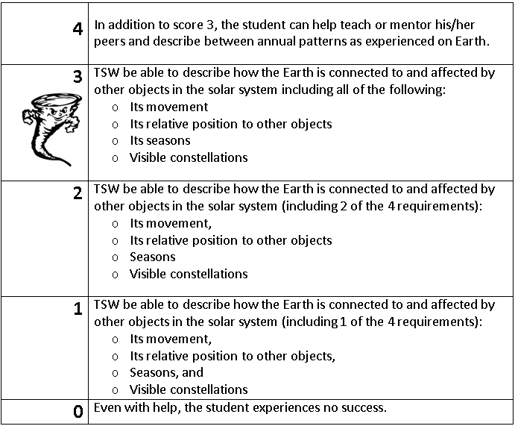
Learning Goal and Scale
TSW be able to describe how the Earth is connected to and affected by other objects in the solar system (including its movement, its relative position to other objects, its seasons, and visible constellations).

